Slide 1

Football Results from 1872 to 2018 Data Visualization

Slide 2
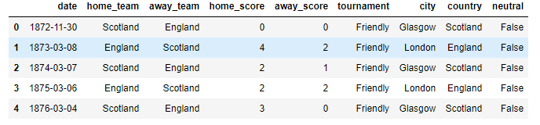
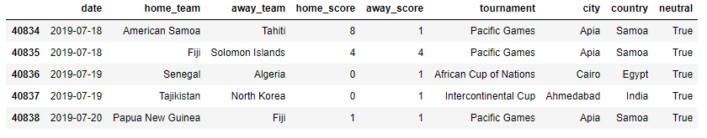
About the Data
Head
Tail

Slide 3
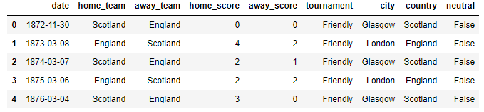
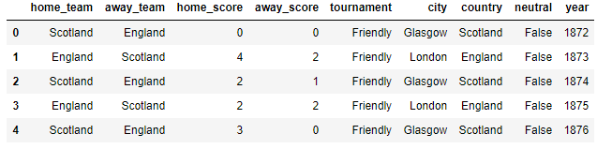
Feature Engineering

Slide 4
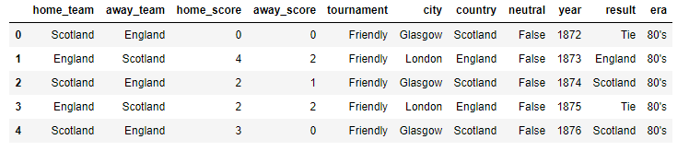
Feature Engineering

Slide 5

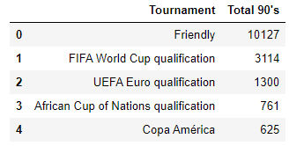
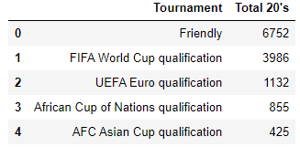
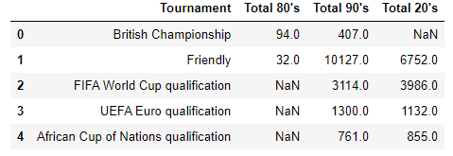
Creations of Table

Slide 6
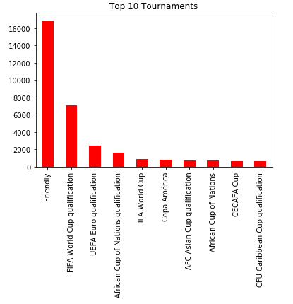
Feature Engineering

Slide 7
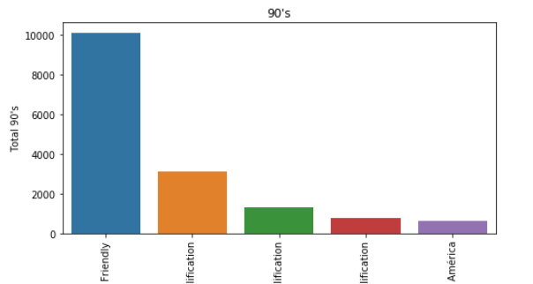
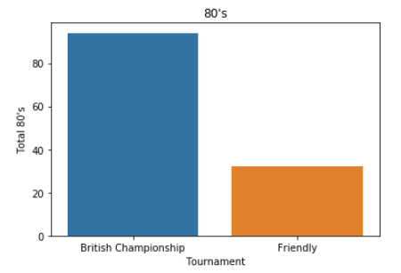



Top Tournament According to Era’s

Slide 8
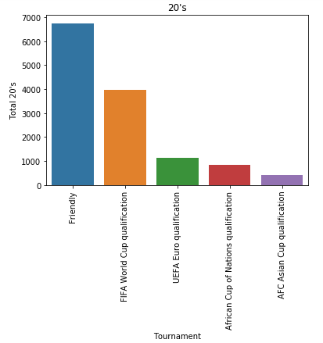
Top Tournament According to Era’s

Slide 9
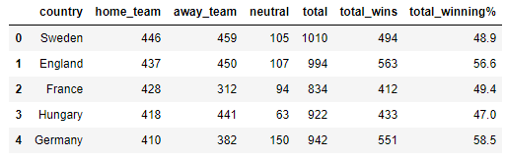
Total Winning%
Original Table
# Home_Team- No. of match played in home
# Away_Team- No. of match played in away
# Neutral_Team- No. of match played in neutral
# Total- Total no. of matches played
#Total_wins- Total wins by a team
Created Table

Slide 10
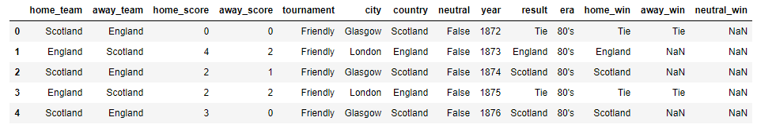
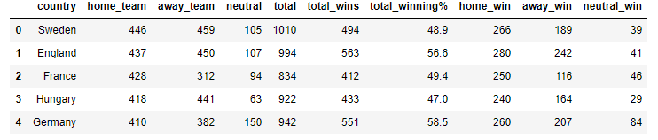
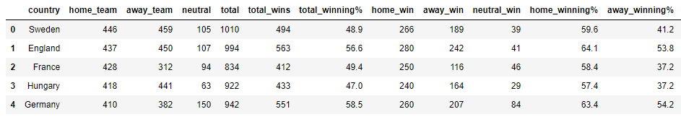
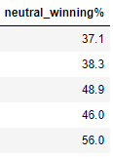

Slide 11
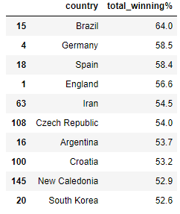
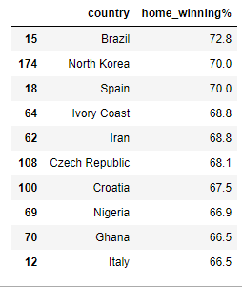
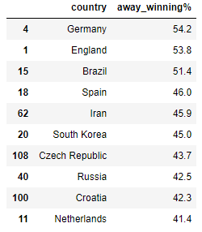
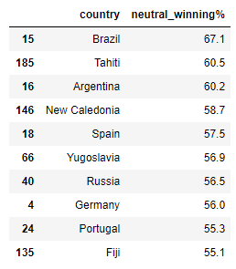
Sorting on the Basis of Highest Winning%
It only includes all those team which played more than 190 matches as the median of total matches is 192

Slide 12
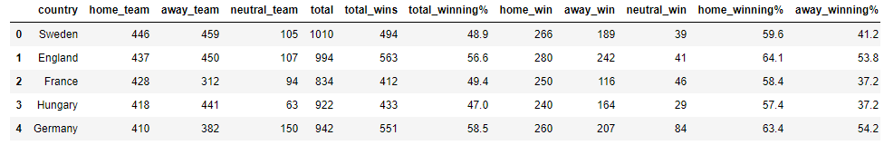
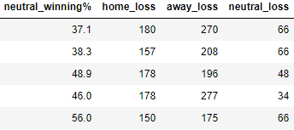
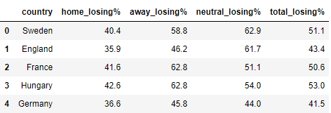
Total Losing%

Slide 13
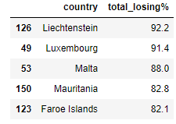
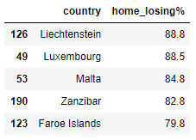
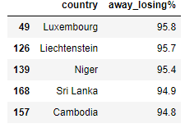
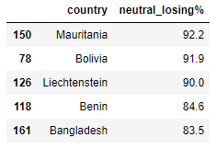
Sorting on the Basis of Highest Losing%
It only includes all those team which played more than 190 matches as the median of total matches is 192

Slide 14
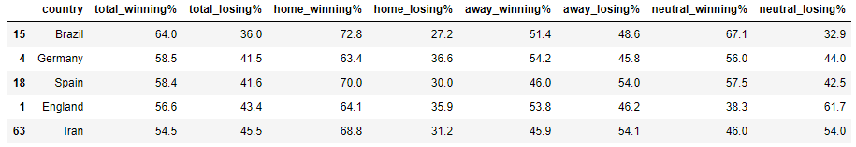
Top 5 Best Team

Slide 15
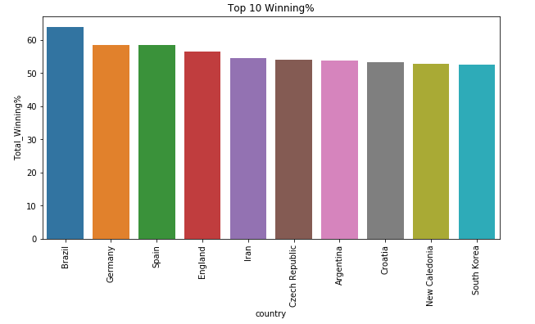
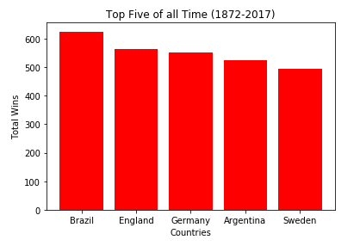
Winning Comparison
On the basis of Winning %
On the basis of total wins

Slide 16
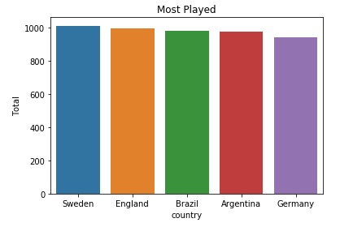
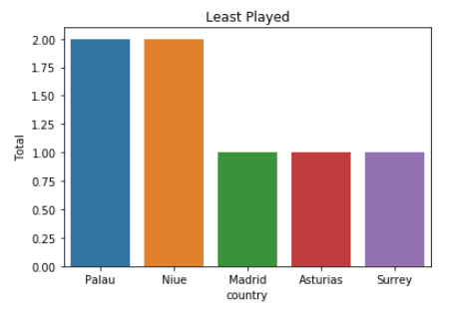
Match Played by each Team

Slide 17
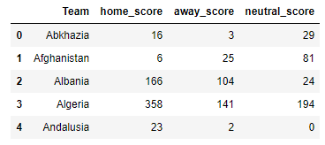
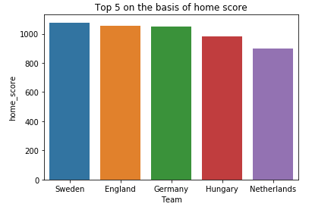
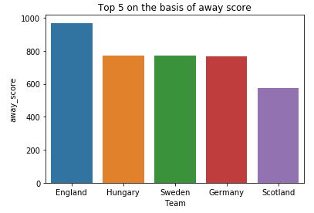
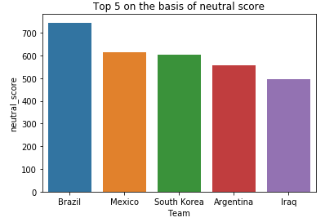
Scores of Each Team
Sorting on the basis of Highest Home score
Sorting on the basis of Highest Away score
Sorting on the basis of Highest Neutral score

Slide 18
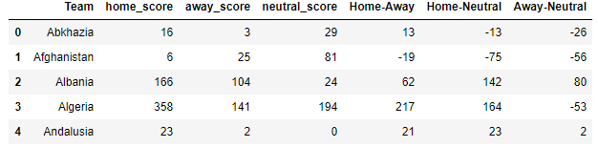
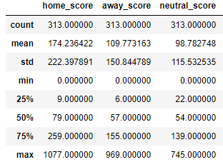
Continue…
According to this the combined median we take is 60

Slide 19
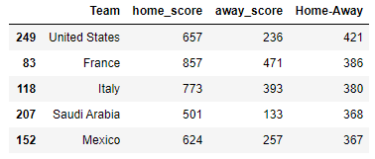
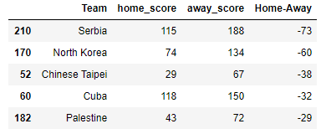
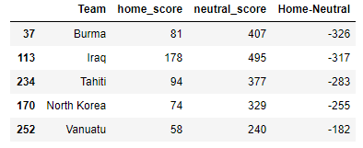
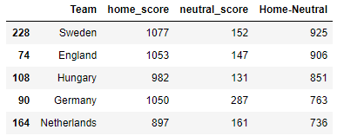
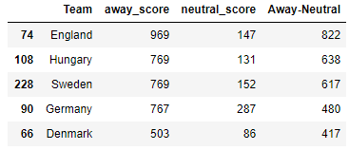
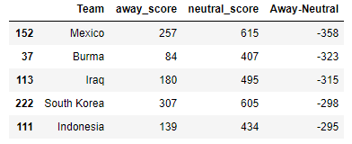
Continue…
These are the top 5 teams who play good in home matches but not good in away matches
These are the top 5 teams who play good in away matches but not good in home matches
These are the top 5 teams who play good in neutral matches but not good in home matches
These are the top 5 teams who play good in home matches but not good in neutral matches
These are the top 5 teams who play good in away matches but not good in home matches
These are the top 5 teams who play good in neutral matches but not good in away matches

Slide 20
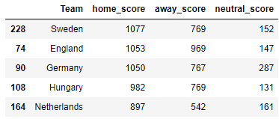
Top 5 Team on the basis of Scores

Slide 21
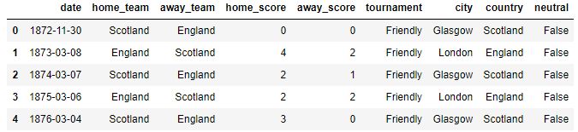
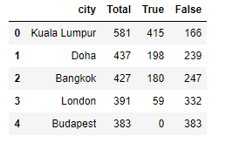
Host Cities
#True means neutral city
#False means not a neutral city

Slide 22
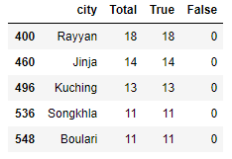
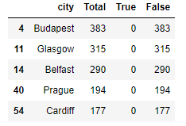


Host Cities
These are the top 5 cities which only host neutral matches
These are the top 5 cities which does not host any neutral matches

